Slide 1
Startup Blueprint Generator
IBM Machine Learning & Cloud Computing PROJECT
Presented By: Dayasankar Panigrahy
Student name : Dayasankar Panigrahy
College Name & Department : Rayagada Autonomous College (Branch: Information Technology)

Slide 2
OUTLINE
Problem Statement
Technology used
Wow factor
End users
Result
Conclusion
Git-hub Link
Future scope
IBM Certifications

Slide 3
Problem Statement
Problem Statement No.20 – Startup Blueprint Generator Agent
The Challenge – A Startup Blueprint Generator Agent, powered by RAG (Retrieval-Augmented
Generation), transforms raw startup ideas into complete, actionable business blueprints.
It retrieves relevant data on market research, funding options, competitor analysis, revenue models,
government schemes, and legal requirements from startup portals, incubator databases, and policy
documents.
Users can describe their idea in simple terms, and the agent provides a structured plan including
business model canvas, estimated budget, go-to-market strategy, and potential investor connections.
The agent eliminates ambiguity and accelerates the journey from idea to implementation.
This AI-driven assistant empowers aspiring entrepreneurs with clarity, resources, and direction to
launch their ventures successfully

Slide 4
Technology used
IBM Watsonx.ai
Granite LLM
Agent Lab
IBM Watson Studio
Jupyter Notebook
IBM Cloud IAM
Python 3
Requests (Python library)
FPDF (Python library)
Git & GitHub

Slide 5
IBM cloud services used
IBM Watsonx.ai → For building and deploying the AI agent (Granite LLM).
IBM Watson Studio → For managing assets, notebooks, and running Python code.
IBM Cloud Identity & Access Management (IAM) → For generating API keys and authenticating requests.
(Optional) IBM Cloud Object Storage → If you uploaded documents/templates for grounding (RAG).

Slide 6
Wow factors
End‑to‑End Blueprint Generation: Instantly converts a rough startup idea into a complete business plan (business model, revenue streams, legal steps, funding options).
RAG‑Powered Contextual Responses: Integrates real‑world documents (e.g., Startup India guides, funding policies) for authentic, India‑specific insights instead of generic AI text.
Personalized Funding Recommendations: Suggests government schemes, incubators, and investors based on budget, stage, and sector.
Automated Go‑to‑Market Strategy: Creates a step‑by‑step launch plan, reducing the time entrepreneurs spend figuring out initial steps.
PDF Blueprint Export: Generates investor‑ready, well‑structured PDF reports with a single click.
Scalable & API‑Ready: Easily integrated into web apps or enterprise platforms for broader use.
Beginner‑Friendly Consulting: Makes startup planning accessible to non‑business founders (students, early‑stage entrepreneurs).

Slide 7
End users
Aspiring Entrepreneurs
Startup Founders
Early‑Stage Startups
Business & Management Students
Startup Incubators & Accelerators
SME Owners

Slide 8
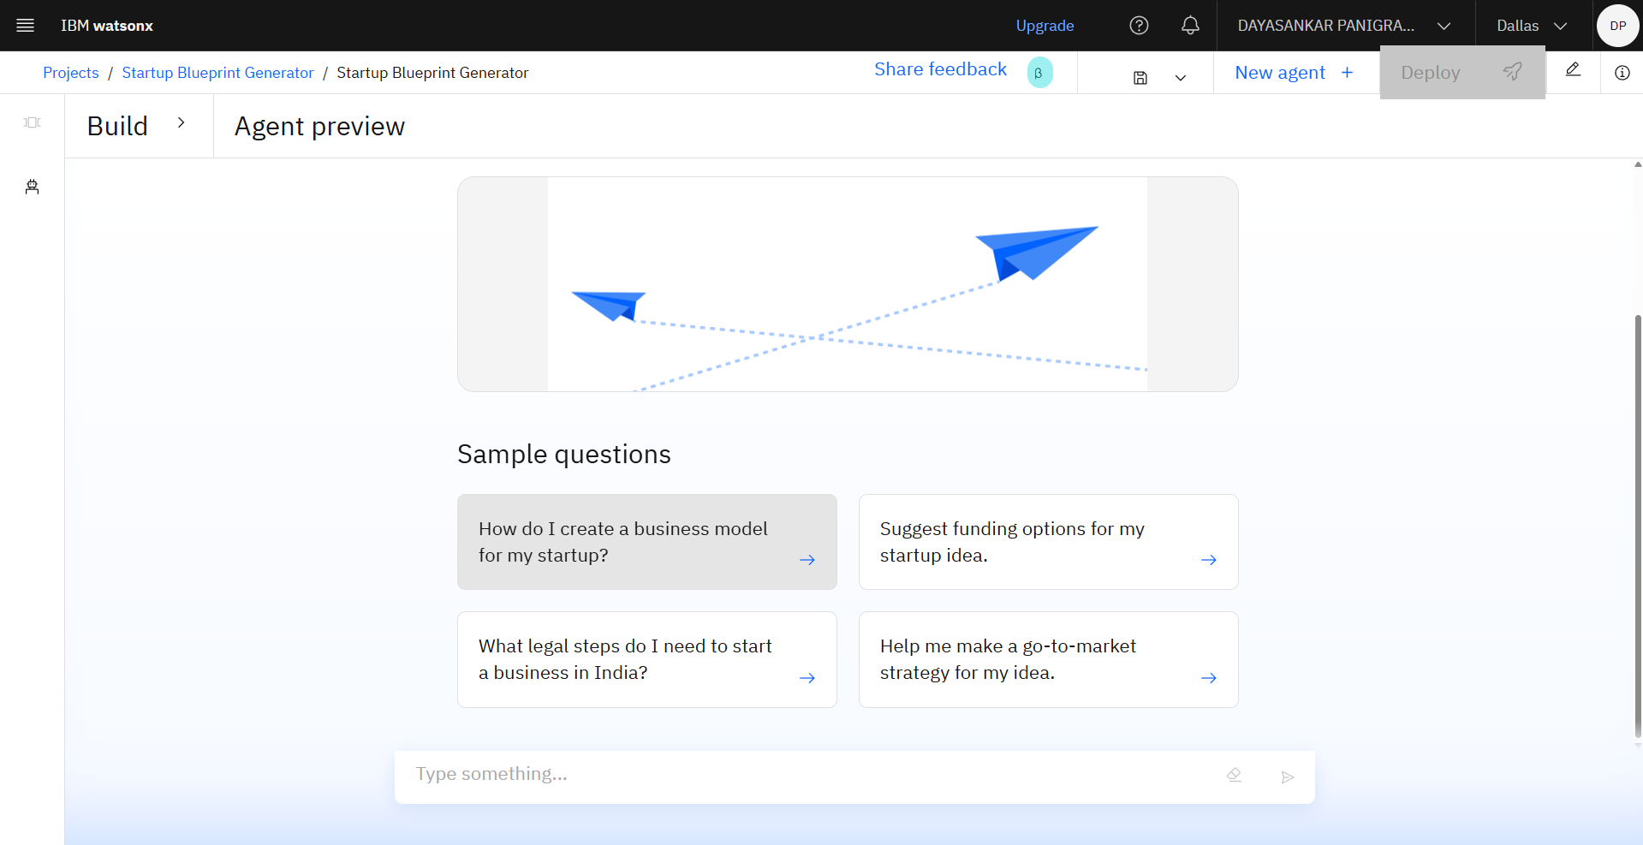
Results

Slide 9
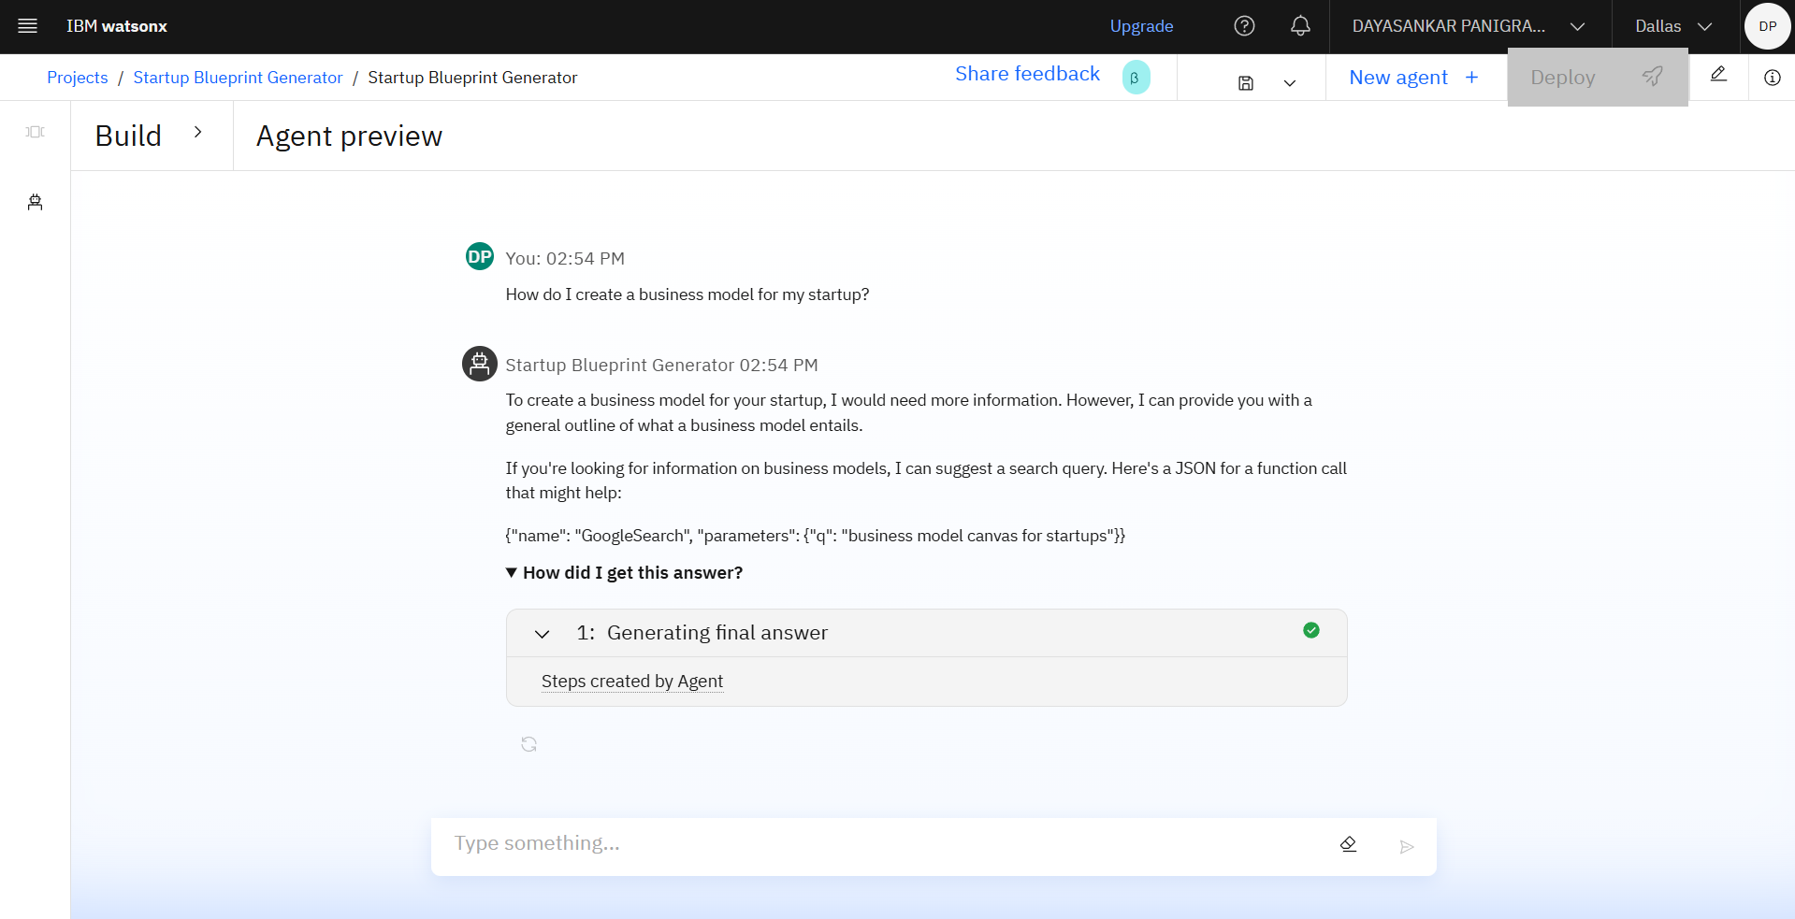
Results

Slide 10
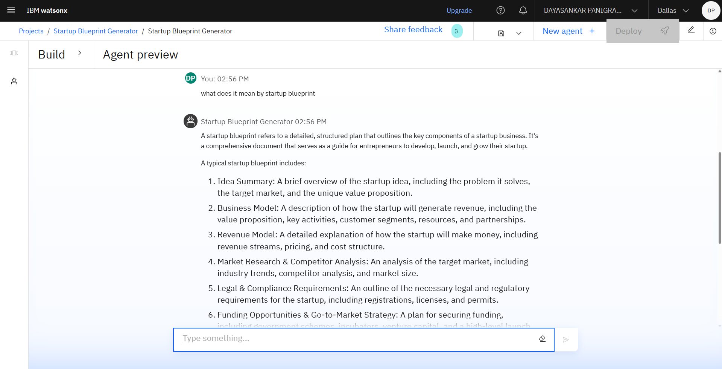
Results

Slide 11
Conclusion
The Startup Blueprint Generator serves as an AI‑powered virtual consultant that empowers aspiring entrepreneurs and early‑stage startups by transforming raw ideas into structured, actionable business blueprints. By integrating IBM Watsonx.ai’s Granite LLM with automated report generation, the project reduces planning time, improves decision‑making, and makes startup consulting accessible to everyone.

Slide 12
GitHub Link
https://github.com/dayasankarpanigrahy/Startup_Bliueprint_Generator.git

Slide 13
Future scope
Industry‑Specific Blueprints: Generate highly customized plans for sectors like health‑tech, ed‑tech, fintech, etc.
Real‑Time Market Data Integration: Pull live data (funding trends, competitor updates) via APIs for up‑to‑date insights.
Investor Pitch Deck Generator: Automatically create pitch presentations alongside business blueprints.
Multi‑Language Support: Assist entrepreneurs in regional languages for wider accessibility.
Collaborative Workspace: Enable multi‑user editing for founders, mentors, and teams.
AI‑Driven Feasibility Scoring: Rate startup ideas on viability based on market, cost, and funding availability.
Integration with Startup Portals: Direct linking with Startup India, incubators, and accelerators for seamless application.

Slide 14
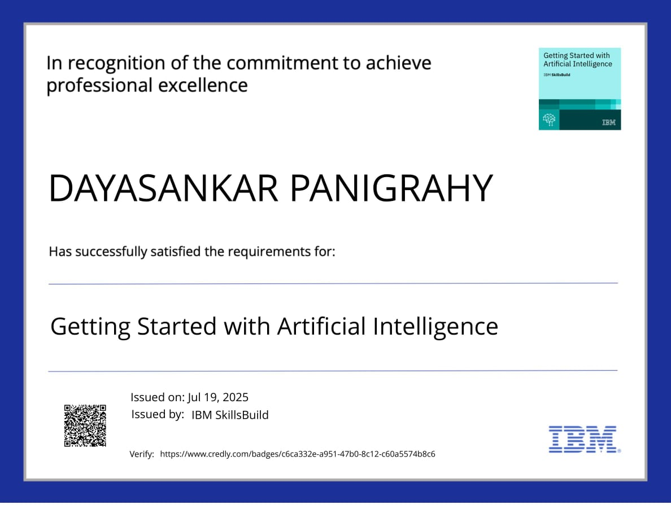
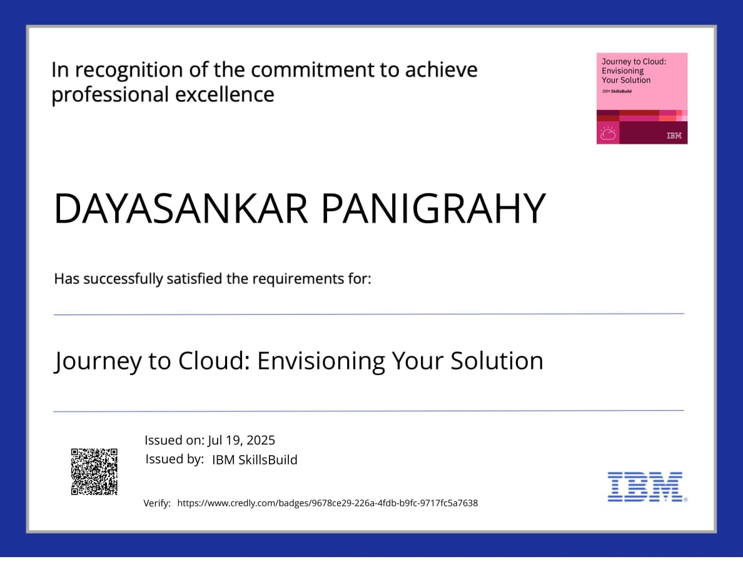
IBM Certifications

Slide 15


Slide 16
THANK YOU

